Slide 1
Normative Ethics I: Principle-Based Theories
Class 13
Philosophy 100
Introduction to Philosophy

Slide 2
Value Theory
Ethics
Social-political thought
Normative: How do we decide on which action is morally correct?
Is there a moral principle that should guide all action? How should we make moral decisions?
Practical: What are the main moral factors in a given domain?
Meta: What do ontological and epistemic considerations bear on moral claims?
We will be focusing on the first two.
What is the best political system?
What is justice?
What legitimizes political authority?
What are our obligations as citizens?
How do freedom and equality relate?
When is a war just?

Slide 3

Normative Ethical Theories
What ought I do?

Slide 4
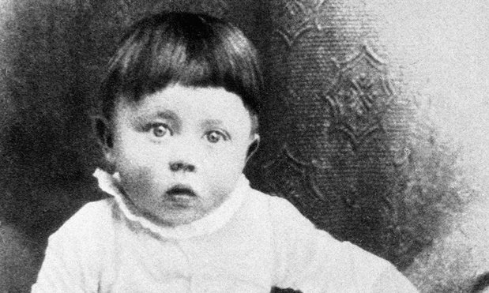
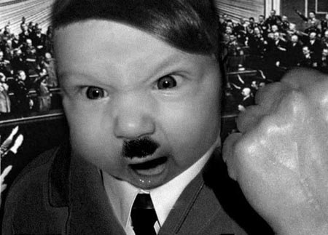
Warm Up
You are walking by a pool and see this child drowning. Are morally obliged to save him?
Suppose that you have a psychic experiences as you are about to save him and discover that he is actually this guy! Are you morally obliged to save him?

Slide 5
Normative Questions
Is the rightness or wrongness of an action contingent on the outcome of that action?
Is one’s intention in an act more important than the outcome that act produced?
What characteristics insure that someone is a moral person?

Slide 6
General NE Views
Principle based
Using an overarching principle to guide one’s moral reasoning in particular instances.
Deontology
Consequentialism
Character based
Making the right decision, at the right time, for the right reasons, because of you’re the right kind of person.
Virtue Ethics

Slide 7
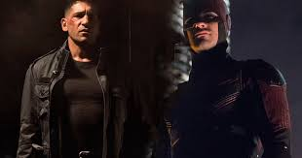
Consequentialism
The Ends Justify the Means

Slide 8

Consequentialist/Results-based Ethics
Consequentialism argues that the morality of an action is contingent on the action's outcome or consequence.
A morally right action is one that produces a good outcome or result, and the consequences of an action or rule generally outweigh all other considerations (i.e. the ends justify the means).

Slide 9
Consequentialism
Consequentialist theories must consider questions like
"What sort of consequences count as good consequences?“
"Who is the primary beneficiary of moral action?“
"How are the consequences judged and who judges them?"
Types of Consequentialism:
Utilitarianism
Hedonism
Egoism
Asceticism
Altruism
Rule Consequentialism
Negative Consequentialism

Slide 10
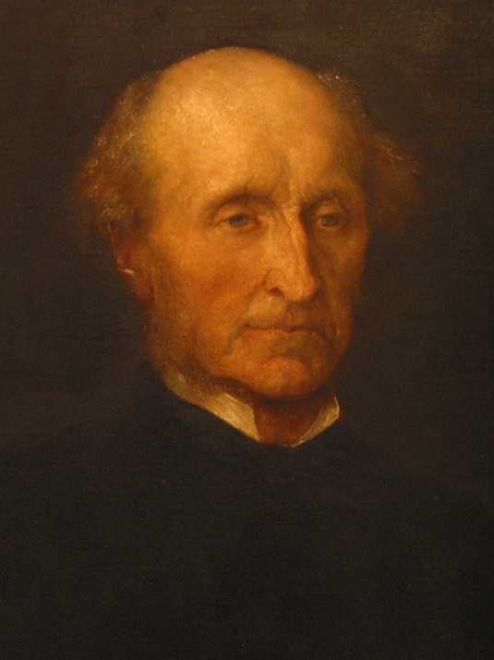
Mill’s Act Utilitarianism
The main principle:
An act morally permissible iff that act produces the maximal amount of pleasure and the minimal amount of pain.
Clarifications:
The principle is to extend to the total pleasure and pain of everyone, not just within oneself.
Pleasure: this is meant to be higher pleasures, not simply hedonistic one's (better to be Socrates than a pig).
The motive behind an act has no bearing on the act's moral standing. The consequence is all that matters. If an act that maximizes the total pleasure is done for the reward money, so what? It's the outcome that matters, not the motivation.

Slide 11
Act Utilitarianism
Serious problems for this view:
Integrity Objection:
Sacrifice an innocent individual to provide organs for three people.
Not pay your neighbor’s kid for mowing your lawn because the money would increase utility elsewhere.
Absurd-Implications Objection:
Opposite acts can be equally moral simply because of outcome.
Justice Objection:
Wrongful conviction to prevent riots.

Slide 12
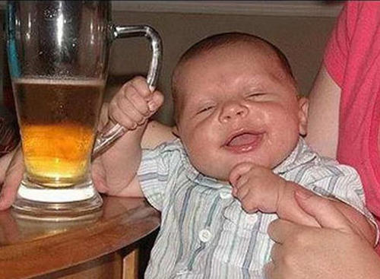
Rule Utilitarianism
An act is right iff it is required by a rule that is a member of a set of rules whose acceptance would lead to greater utility than any available alternative.
Attractiveness of this theory :
It is a single principle with an answer for every situation.
It purportedly captures the substance of morality—offers a broad outline for choosing principles but itself doesn’t stipulate any.

Slide 13
Rule Utilitarianism Response to Challenges
Serious problems for this view:
Integrity Objection:
Rules preventing us from breaking contracts and sacrificing innocent individuals seems like it would increase over-all utility.
Absurd-Implications Objection:
It’s the outcome that matters, not the action that brought it about.
Justice Objection:
Justice is not absolute.
Sometimes things like mercy and benevolence and the good of the whole society can supersede justice.
Or perhaps having human rights which cannot be violated is a result of utility outcomes. So one’s rights are by rule something that shouldn’t be forsaken, although they are not absolute.

Slide 14
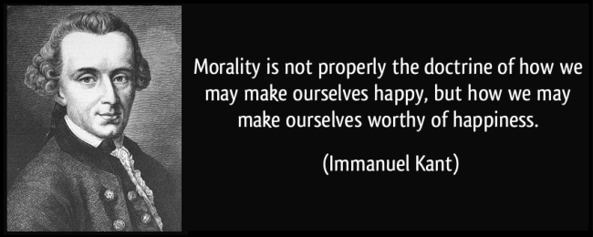
Deontology
According to Kant

Slide 15
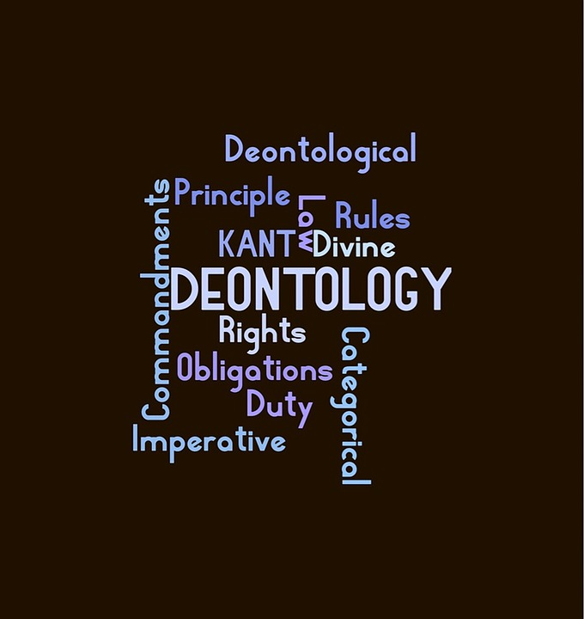
Deontology/Duty-based Ethics
Deontology (or Deontological Ethics) focuses on the rightness or wrongness of actions themselves, as opposed to the rightness or wrongness of the consequences of those actions or to the character and habits of the actor.

Slide 16
Deontology
To a Deontologist, whether a situation is good or bad depends on whether the action that brought it about was right or wrong. What makes a choice "right" is its conformity with a moral norm: Right takes priority over Good.
For example, if someone proposed to kill everyone currently living on land that could not support agriculture in order to bring about a world without starvation, a Deontologist would argue that this world without starvation was a bad state of affairs because of the way in which it was brought about.

Slide 17
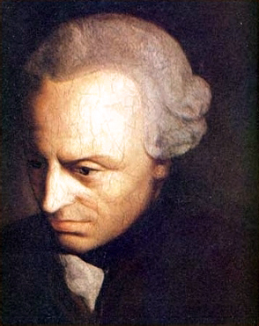
Kantian Ethics
Kant claims that there is a supreme principle of morality, the categorical imperative:
An act A is morally permissible iff
A could be willed to be universal and
A does not use people as mere means but as ends in themselves.

Slide 18
First Maxim: An act must be universalizable.
The way we test if an act is categorical is if it can be willed to be universal without contradiction.
By contradiction, we mean that if willed to be a universal the act would undermine the very notion used in the action.

Slide 19

Second Maxim: Treat people as ends not means
We should never exploit, manipulate, or use others as a means for our own ends, with no mutual benefit.

Slide 20
Example
Suppose I ‘borrow’ five dollars from you without ever intending to pay it back—I’m going to give it to the homeless person who needs it more than both of us, but I don’t have the money to give myself.

Slide 21
Employing the Maxims
Universalizability
Means-Ends
Maxim: When I am short of money and need it, I can borrow some without intending to pay it back, even if I say that I will pay it back.
This is contradictory because the act of promising would be thereby null of meaning if there were times when keeping one's promise was negotiable.
Lying is using someone as a means and not an end in themselves because lying is a way to get the person to do something for my ends.

Slide 22
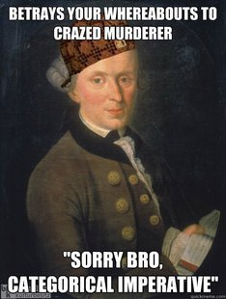
Challenging Example
An axe murder comes to the door and asks if your home. I tell him no, because I know he will kill you otherwise.
Given the categorical imperative, this is immoral.

Slide 23
Broader Question
What’s the difference between Rule UTL and a deontological ethic?
The primary difference between deontology and utilitarianism, two competing systems of ethics, is that the former system is concerned with whether an act is intrinsically right or wrong, while the latter system believes that only the consequences of an act are important.
Deontology deals with intentions and motives; rule UTL deals with rules that promote the best outcomes regardless of motive.

Slide 24


